Slide 1
SQL WORKSHOP SERIES
Brought to you by RECESS and IEEE Computer Chapter

Slide 2
Setup
Download PostgreSQL. During the installation, set up your server.
IMPORTANT: Remember the username and password you entered
https://www.postgresql.org/download/
Download Jetbrains DataGrip (30 day trial or get a student account so you can use it for FREE)
https://www.jetbrains.com/datagrip/

Slide 3
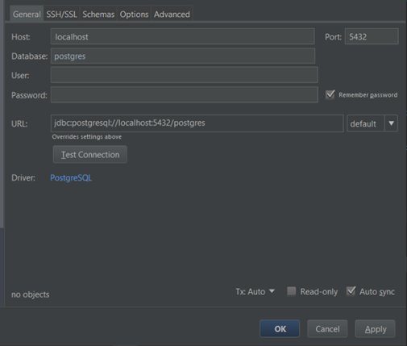
Setup
In DataGrip, add a new PostgreSQL Data Source. Add in the username and password from the PostgreSQL setup (see User and Password textbox in the picture to the right)
Be sure to test the connection to your server (click the Test Connection button). It should say Successful next to the button.
Click OK
Run the SQL file that was provided to you. It’ll create the tables you need for this workshop.

Slide 4
Intro
SQL stands for Structured Query Language
Used to query, manipulate and transform data in databases
Data is stored in tables or a series of 2-D arrays
There many different kinds of SQL databases (PostgreSQL, SQLite, MySQL). The main difference is the vendor behind them and a few features.
Don’t worry about this.
The SQL queries you will be learning are supported by all of these implementations.

Slide 5
What is a Database
A collection of related tables (think of a table as an Excel spreadsheet) with a fixed number of columns for each attribute related to the data
If I had a database about cats, then I would have a table dedicated information about the cats. This way I could answer questions like which cats are less than 5 years old or how many cats have the name Fluffy?
Id | Name | Age | Color | Weight | Likes_Belly_Rubs
1 | Chico | 9 | B&W | 5.2 | TRUE/Yes Please
2 | Marilyn | 6 | B&W | 4.2 | FALSE/Good luck with that
3 | Leona | 4 | Ginger | 3.8 | TRUE/GIVE ME ALL THE BELLY RUBS
4 | Kiki | 11 | Grey | 4.5 | FALSE/You’re gonna lose a hand
5 | Deuce | 7 | White | 4.0 | TRUE/Why did you stop? Pet me more

Slide 6
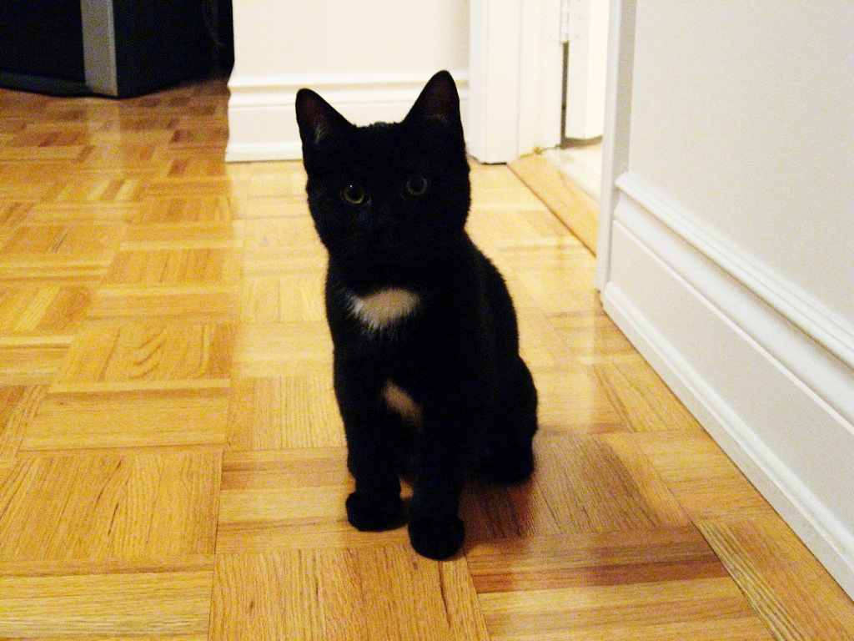
Kitty (felis silvestris catus)

Slide 7

Writing SQL Queries: SELECT Statements
SELECT * FROM tableName
Give me all the columns from tableName
Example: SELECT * FROM cats
Id | Name | Age | Color | Weight | Likes_Belly_Rubs
1 | Chico | 9 | B&W | 5.2 | TRUE/Yes Please
2 | Marilyn | 6 | B&W | 4.2 | FALSE/Good luck with that
3 | Leona | 4 | Ginger | 3.8 | TRUE/GIVE ME ALL THE BELLY RUBS
4 | Kiki | 11 | Grey | 4.5 | FALSE/You’re gonna lose a hand
5 | Deuce | 7 | White | 4.0 | TRUE/Why did you stop? Pet me more

Slide 8
Writing SQL Queries: SELECT Statements
SELECT columnName1, column2, … columnNameN FROM tableName
Give me these columns from tableName
Example: SELECT Name, Likes_Belly_Rubs FROM cats
Name | Likes_Belly_Rubs
Chico | TRUE/Yes Please
Marilyn | FALSE/Good luck with that
Leona | TRUE/GIVE ME ALL THE BELLY RUBS
Kiki | FALSE/You’re gonna lose a hand
Deuce | TRUE/Why did you stop? Pet me more

Slide 9
Writing SQL Queries: SELECT Statements
Try it yourself
Write a SELECT statement that gives you the name, age and color of each cat
SELECT name, age, color FROM cat
TIP: SQL is case insensitive. This means sEleCT * fROm caTS is the same as SELECT * FROM cats

Slide 10
Writing SQL Queries: WHERE Keyword
SELECT * FROM cats WHERE condition
Give me all the columns from the table cats where condition is true
Operator | Condition | SQL Example
=, !=, < <=, >, >= | Standard numerical operators | columnName != 4
BETWEEN … AND … | Number is within range of two values (inclusive) | columnName BETWEEN 1.5 AND 10.5
NOT BETWEEN … AND … | Number is not within range of two values (inclusive) | columnName NOT BETWEEN 1 AND10
IN (…) | Number exists in a list | columnName IN (2, 4, 6)
NOT IN (…) | Number does not exist in a list | columnName NOT IN (1, 3, 5)

Slide 11
Writing SQL Queries: WHERE Keyword
Example: SELECT * FROM cats WHERE age < 7
Try it yourself: Write a SELECT statement that returns…
All the data about cats that like belly rubs
The name and weight of the cats more than 4.5 (kg)
The name and weight of the cats more than 4.5 (kg) but using NOT and a different operator than before
HINT: Use NOT to inverse the result of an operator. Ex: NOT columnName = 5 is the same as columnName != 5
The name and age of the cats between 5 and 8 years old (inclusive)
All the data on cats that are 4, 7 and 11 years old
Id | Name | Age | Color | Weight | Likes_Belly_Rubs
2 | Marilyn | 6 | B&W | 4.2 | FALSE/Good luck with that
3 | Leona | 4 | Ginger | 3.8 | TRUE/GIVE ME ALL THE BELLY RUBS

Slide 12
Answers: Write a SELECT statement that returns…
All the data about cats that like belly rubs
SELECT * FROM cats WHERE likes_belly_rubs = TRUE
The name and weight of the cats more than 4.5 (kg)
SELECT name, weight FROM cats WHERE weight > 4.5
The name and weight of the cats more than 4.5 (kg) but using NOT and a different operator than before
SELECT name, weight FROM cats WHERE NOT weight <= 4.5
The name and color of the cats between 5 and 8 years old (inclusive)
SELECT name, color FROM cats WHERE age BETWEEN 5 AND 8
All the data on cats that are 4, 7 and 11 years old
SELECT * FROM cats WHERE age IN (4, 7, 11)

Slide 13
Writing SQL Queries: WHERE Keyword
Operator | Condition | Example
= | Case sensitive exact string comparison (single =) | col_name = "abc"
!= or <> | Case sensitive exact string inequality comparison | col_name != "abcd"
LIKE | Case insensitive exact string comparison | col_name LIKE "ABC"
NOT LIKE | Case insensitive exact string inequality comparison | col_name NOT LIKE "ABCD"
% | Used anywhere in a string to match a sequence of zero or more characters (only with LIKE or NOT LIKE) | col_name LIKE "%AT%" (matches "AT", "ATTIC", "CAT" or even "BATS")
_ | Used anywhere in a string to match a single character (only with LIKE or NOT LIKE) | col_name LIKE "AN_" (matches "AND", but not "AN")
IN (…) | String exists in a list | col_name IN ("A", "B", "C")
NOT IN (…) | String does not exist in a list | col_name NOT IN ("D", "E", "F")

Slide 14
Writing SQL Queries: WHERE Keyword
Example: SELECT * FROM cats WHERE color = ‘B&W’
Try it yourself: Write a SELECT statement that returns…
All the data about cats who’s name aren’t Deuce
The name and color of the cats who’s color starts with G
The names of the cats that have the letter a in their name
The name and age of the cats who’s color’s second last letter is e
Id | Name | Age | Color | Weight | Likes_Belly_Rubs
1 | Chico | 9 | B&W | 5.2 | TRUE/Yes Please
2 | Marilyn | 6 | B&W | 4.2 | FALSE/Good luck with that

Slide 15
Answers: Write a SELECT statement that returns…
All the data about cats who’s name aren’t Deuce
SELECT * FROM cats WHERE name != 'Deuce'
The name and color of the cats who’s color starts with G
SELECT name, color FROM cats WHERE color LIKE 'G%'
The names of the cats that have the letter a in their name
SELECT name FROM cats WHERE name LIKE '%a%‘
The name and age of the cats who’s color’s second last letter is e
SELECT name, age, color FROM cats WHERE color LIKE '%e_'

Slide 16
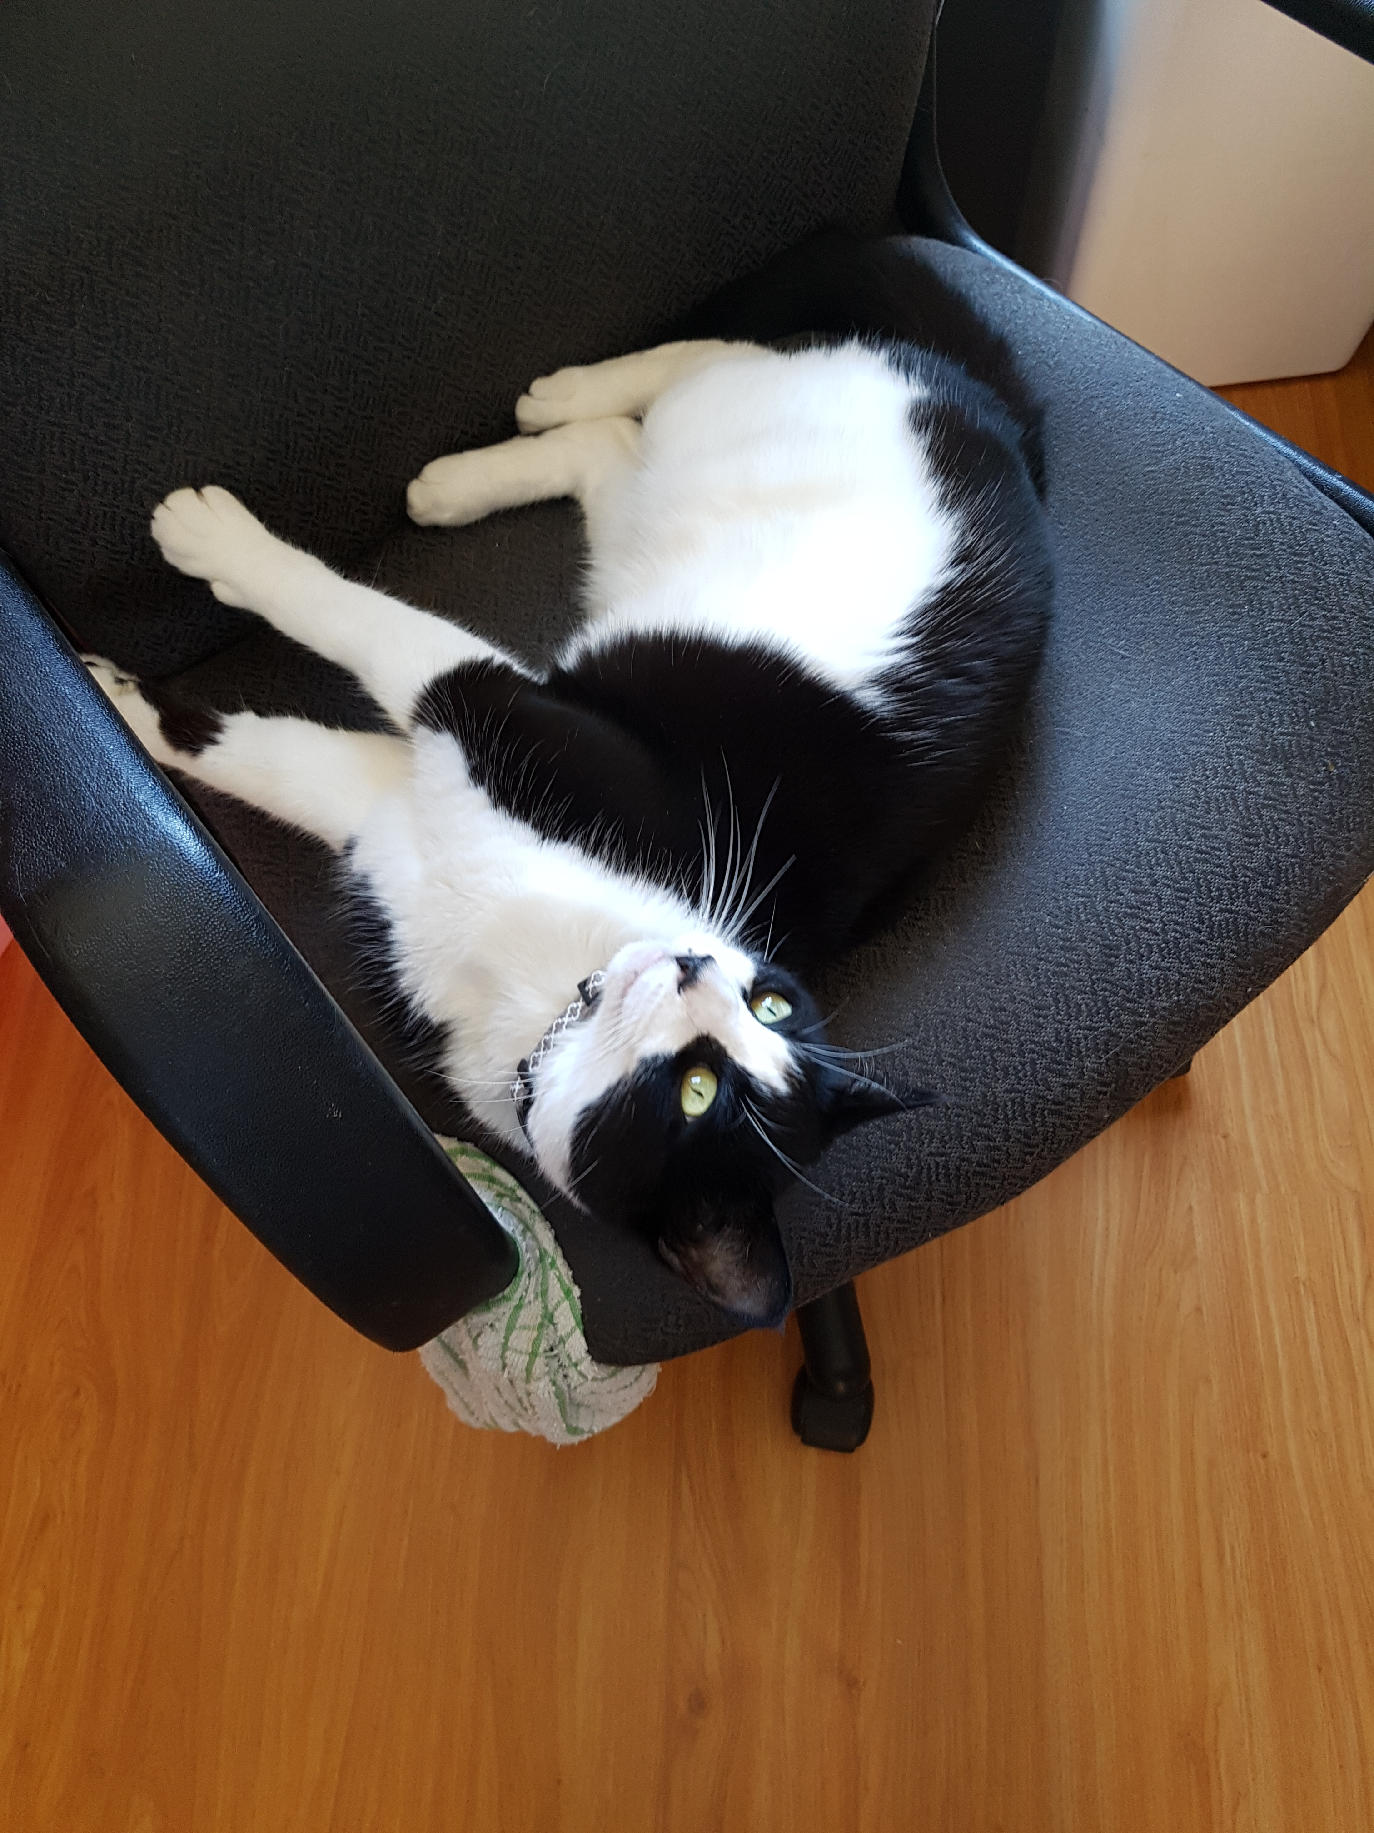
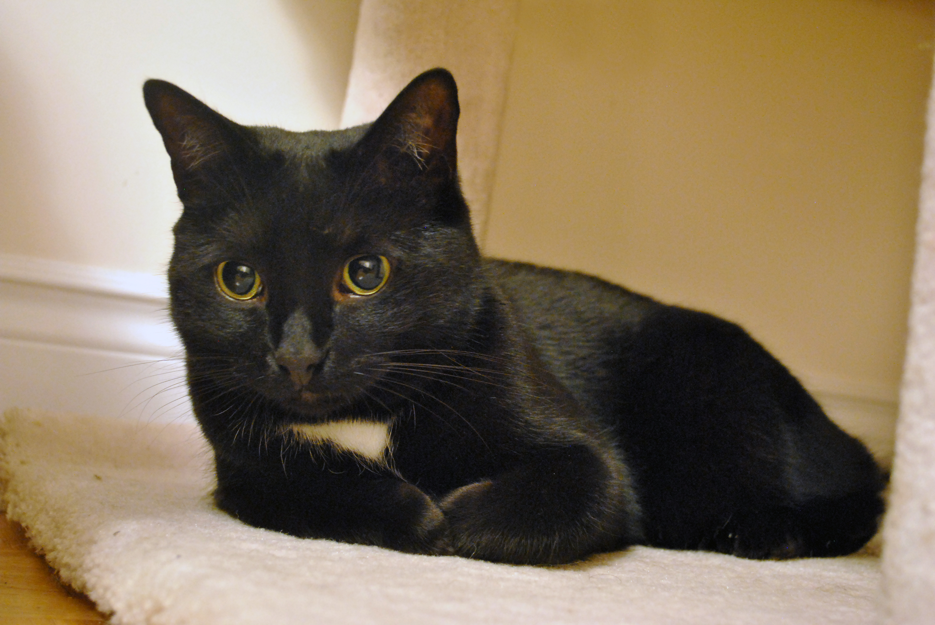
REMEMBER: 2 Black and White Cats
Marilyn
Chico

Slide 17
Writing SQL Queries: DISTINCT Keyword
The DISTINCT keyword removes all duplicate rows from any results your query would normally return
Example: SELECT DISTINCT color FROM cats WHERE color = 'B&W'
Remember that there are 2 cats that are black and white but only one is shown here.
If you run the above query without the DISTINCT keyword then you get this:
Color
B&W
Color
B&W
B&W

Slide 18
Writing SQL Queries: ORDER BY Keyword
The ORDER BY keyword obviously orders the output by a certain criteria.
This can be done with numbers (ascending or descending), words (alphabetical or unalphabetical), date/time (past to future or future to past) or any other attribute
The keyword ASC (default)or DESC is added to the end of the query in order to control the ordering
Example: SELECT name, age FROM cats ORDER BY age
Name | Age
Leona | 4
Marilyn | 6
Deuce | 7
Chico | 9
Kiki | 11

Slide 19
Writing SQL Queries: LIMIT and OFFSET Keyword
The LIMIT keyword reduces the number of rows returned, and the optional OFFSET specifies where to begin counting the offset from
Lets say I want to get the 2 lightest cats names but I don’t want to include the lightest (Leona) because she’s the youngest.
SELECT name FROM cats ORDER BY weight LIMIT 2 OFFSET 1
Name | Weight
Leona | 3.8
Deuce | 4.0
Marilyn | 4.2
Kiki | 4.5
Chico | 5.2
Name
Deuce
Kiki

Slide 20
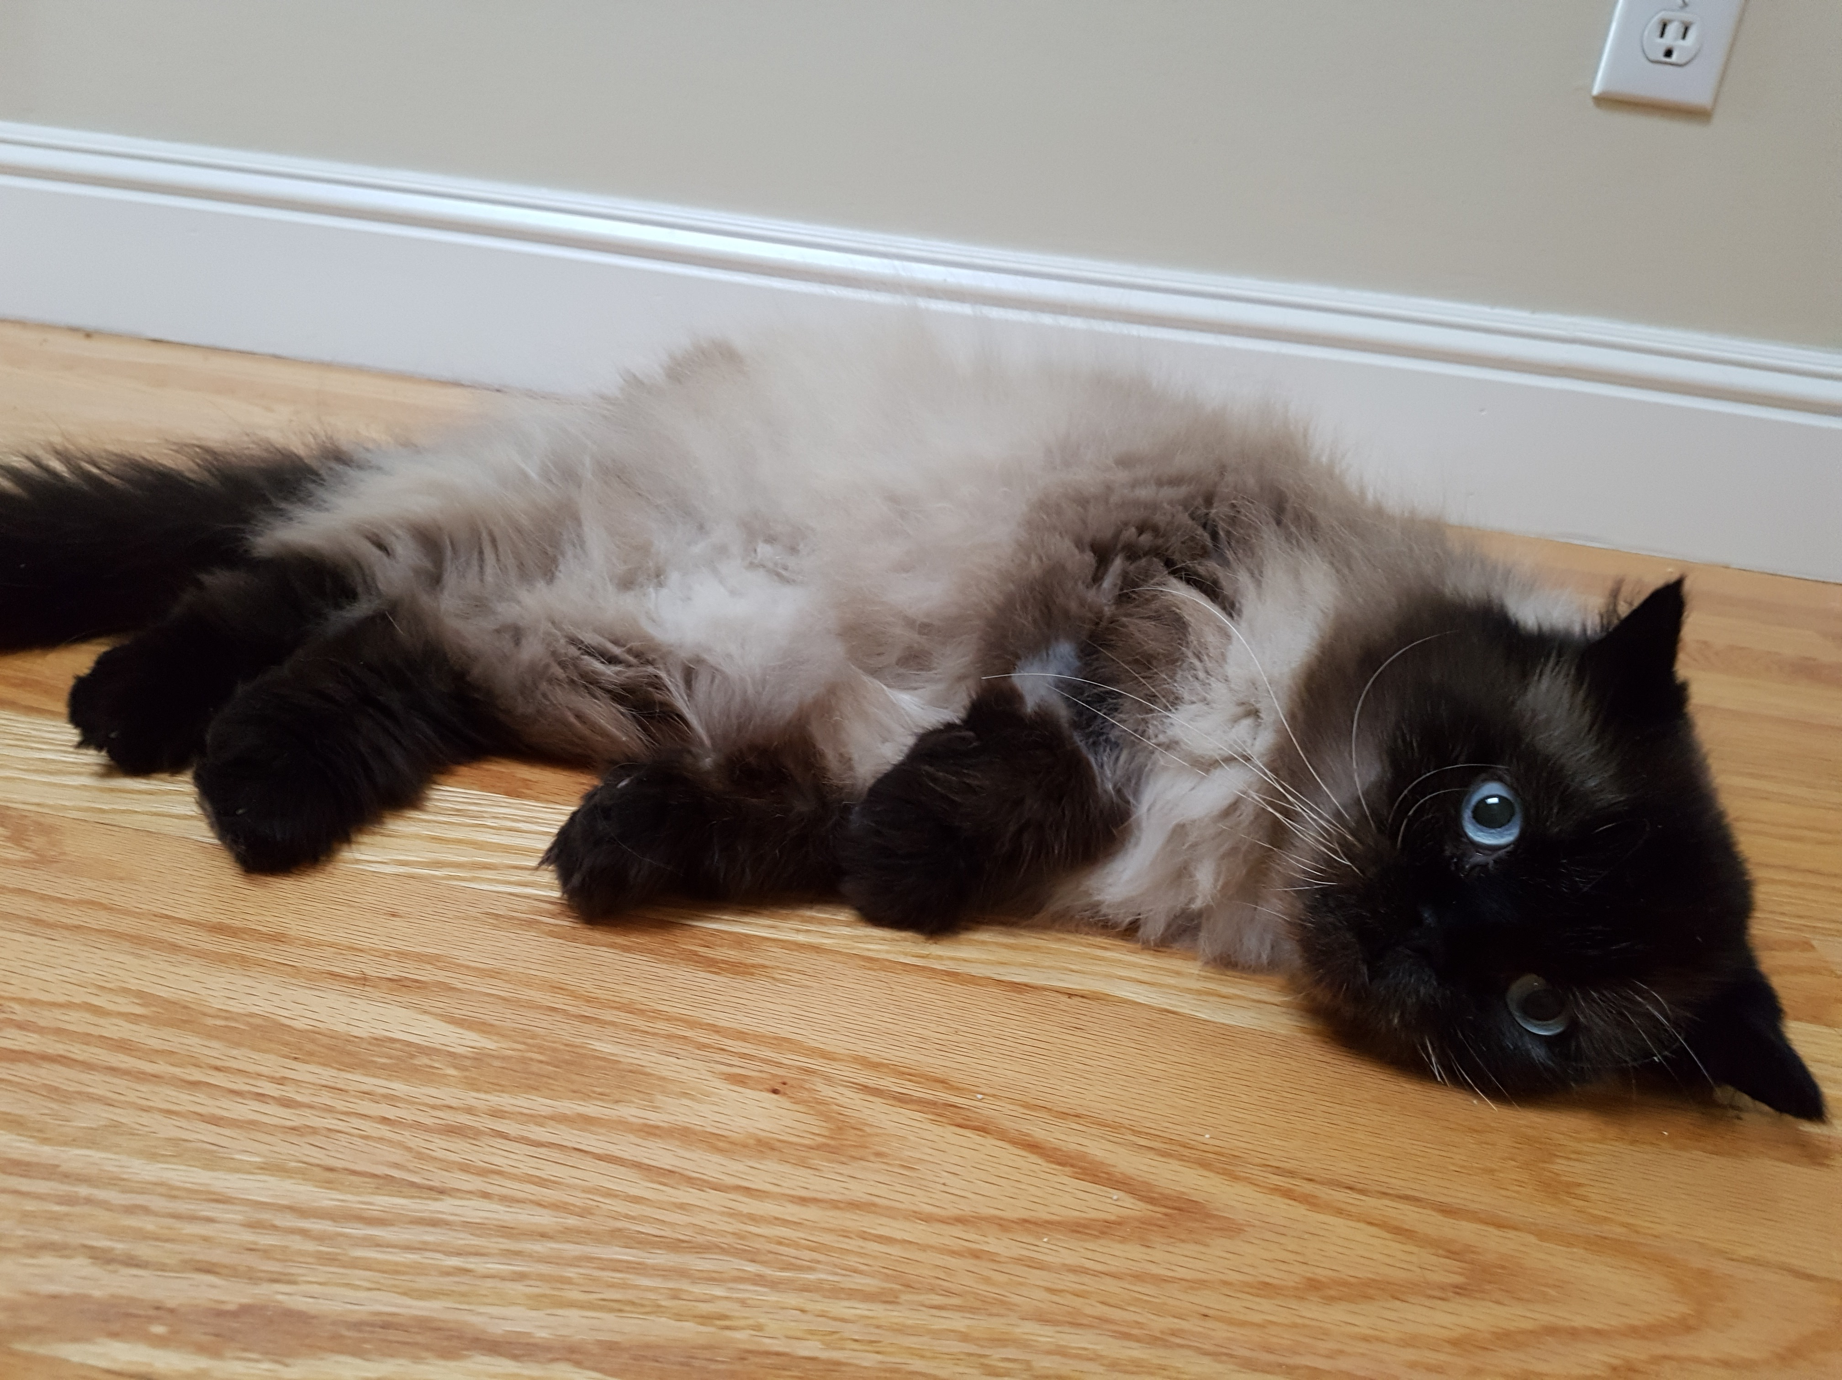
Deuce

Slide 21
REVIEW SELECT STATEMENTS
SELECT columnName1, columnName2, …
FROM tableName
WHERE condition(s)
ORDER BY column ASC/DESC
LIMIT num_limit OFFSET num_offset;

Slide 22
MOVIES Database Snapshot
id | Title | Director | Year | Length | Rating
1 | 21 | Robert Luketic | 2008 | 123 | 6.8
2 | The Avengers | Joss Whedon | 2012 | 143 | 8.1
3 | Captain America: The Winter Soldier | Joe Russo | 2014 | 136 | 7.8
4 | The Dark Knight | Christopher Nolan | 2008 | 152 | 9
5 | Dead Poets Society | Peter Weir | 1989 | 128 | 8
6 | Death of a Superhero | Ian Fitzgibbon | 2011 | 97 | 7.1

Slide 23
PRACTICE – WRITE A SELECT STATEMENT THAT RETURNS…
The title and duration of movies with a running time of less than 2 hours, ordered by length (longest to shortest)
The title and year of movies made between 2000 and 2010 (exclusive) in alphabetical order
All the data about the last 3 movies made before the year 2000
The directors of movies made in the last 20 years with a rating of 8.5 or higher (no duplicates)
The titles of the 3rd and 4th longest movies in the database

